Slide 1
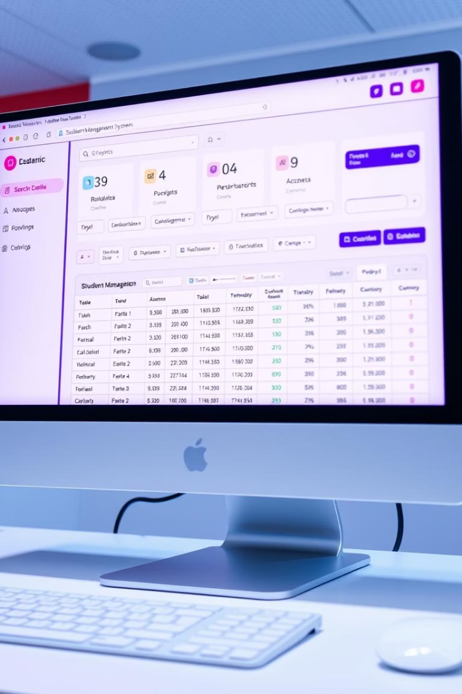
Student Management System
This presentation outlines a robust Student Management System built using Object-Oriented Programming (OOP) principles in Java. It provides administrators with comprehensive tools to manage student records efficiently and reliably.
Group Name:- FANTASTIC FOUR
TEAM MEMBERS NAME
VIRAT(24SCSE1010529) YASH MISHRA PANKAJ KUMAR CHETAN

Slide 2

Project Overview & Core Features
System Capabilities
Add, update, delete, and view student records.
Search for students by ID or name.
Validate input data to prevent errors.
Handle exceptions gracefully.
Save and load data from persistent storage.
The system is designed for ease of use and data integrity, ensuring all student information is managed effectively and securely.

Slide 3





OOP Design: Class Structure
Student Class
Represents a student with attributes like ID, name, age, and grade.
StudentManagementSystem Class
Handles all core operations: add, update, delete, and search functionalities.
FileHandler Class
Manages file input/output for data persistence, ensuring data is saved and loaded correctly.
Main Class
Serves as the entry point, providing a simple console user interface for interaction.
This modular design ensures clear separation of concerns, making the system maintainable and scalable.

Slide 4




Robustness: Error Handling & Validation
Input Validation
Exception Handling
Graceful Error Messages
Ensures data integrity by validating inputs (e.g., age must be numeric, name cannot be empty).
Gracefully manages errors during file operations (e.g., FileNotFoundException, IOException).
Provides clear feedback to users, such as "Student not found" or "Invalid input."
These measures ensure the system remains stable and user-friendly, even when unexpected inputs or issues occur.

Slide 5






Seamless Integration of Components
StudentManagementSystem
Interacts directly with the FileHandler to ensure data persistence for all operations.
FileHandler
Responsible for saving and loading student data to and from files.
Main Class
Utilizes the StudentManagementSystem to execute all user-requested operations.
This interconnected structure allows for efficient data flow and operation execution across the system's various components.

Slide 6

Code Quality & Innovation
Modular Code
Clean Methods
Separated into logical classes, enhancing readability and maintainability.
Adheres to the single responsibility principle, ensuring each method performs a specific task.
Innovations
Auto-generated student IDs.
Case-insensitive search functionality.
Automatic data backup on exit.
These features contribute to a robust, user-friendly, and highly efficient student management system.

Slide 7



Comprehensive Project Documentation
README
Code Comments
User Manual
Provides a setup guide and outlines all key features of the system.
Explains the core logic within the source code for better understanding.
A detailed guide on how to effectively use the Student Management System.
Thorough documentation ensures that users and developers can easily understand, set up, and utilize the system.

Slide 8



Key Takeaways & Next Steps
Evaluation Criteria Met
The system successfully meets all specified criteria, including CRUD operations, error handling, and code quality.
Future Enhancements
Potential for a graphical user interface (GUI) and network capabilities for multi-user access.
Collaboration
Open to contributions and further development to expand system functionalities.
This project serves as a strong foundation for a scalable and feature-rich student management solution.

Slide 9
Thank you

